Slide 1
Scrum-Agile
Pawan Gaire
Cs-250
06/22/2024
Sprint review and retrospective

Slide 2
Scrum-Agile Team Roles: Product Owner
Responsibilities:
Acts as the voice of the business sponsor.
Responsible for optimizing the team's output value.
Manages the backlog efficiently by:
Clearly communicating backlog items for team understanding
Prioritizing tasks to align with goals and mission
Ensuring the backlog is accessible and transparent
Indicating upcoming tasks for the team

Slide 3
Scrum-Agile Team Roles: Developers
Responsibilities:
Make sure they deliver a working part of the product each Sprint
Responsible for:
Planning what to do in the Sprint and keeping track of tasks
Ensuring high quality by following clear guidelines
Updating their plans daily to stay on track with goals
Supporting each other by: Having all the needed skills to build the product, Working as one team, not splitting into smaller groups.
Deciding on their own how to turn tasks into working features

Slide 4
Scrum-Agile Team Roles: Scrum Master
Responsibilities:
Ensure Scrum practices are followed, and the team is effective.
Act as a supportive leader for the Scrum Team and organization by:
Coaching team members in self-management and teamwork.
Helping create valuable work that meets quality standards.
Removing obstacles and facilitating stakeholder collaboration.
Making sure Scrum events are positive, productive, and on time.
Assisting in defining goals and managing the backlog.
Training and guiding the organization in using Scrum.
Avoid directing the team, as they are self-organizing

Slide 5
How is Agile Structured?
Agile software development divides the project into repeated phases that keep going. Unlike traditional methods that start with planning and finish after all features are done, Agile focuses on developing each feature separately. Features are split into user stories and developed in short cycles called sprints. Each sprint follows a circular path of phases that can be repeated until the features are complete.

Slide 6
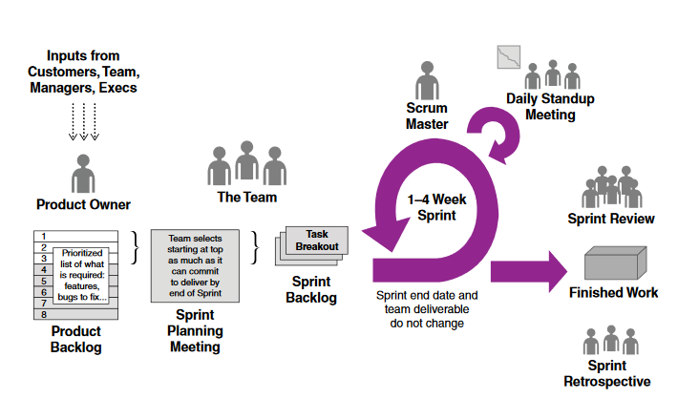
Phases of software development in Agile methodology
Requirements Gathering: Gathering and understanding project requirements.
Sprint Planning: Planning the tasks to be accomplished in the upcoming sprint.
Development: Implementing and coding the features based on user stories.
Daily Scrum: Daily meetings to discuss progress, challenges, and plans.
Sprint Review: Reviewing the completed work with stakeholders.
Sprint Retrospective: Reflecting on the sprint to improve processes.
Deployment: Continuously deploying new features based on feedback.

Slide 7
Agile vs Waterfall
Agile:
Circular Approach: Development happens in repeating cycles, allowing for continuous improvement.
Regular Feedback: Frequent input from stakeholders helps keep the project on track.
Easy to Add/Make Changes: Changes can be made easily at any point during the project.
Waterfall:
Linear Approach: Development follows a step-by-step process, moving from one phase to the next.
Limited Feedback: Feedback is usually only gathered at the end, making it hard to address issues during the project.
Changes Require Extra Planning: Any changes after planning are hard to implement and need thorough re-planning.

Slide 8
Agile Vs Waterfall (Based on Our Project)
In our recent sprint, the product owner held a focus group with potential users and realized that a new direction was needed for the product. Due to ongoing feedback and effective communication within the Scrum team, the developers quickly incorporated these new features into the product without causing any delays in production.

Slide 9
Factors to Consider While Choosing Waterfall or Agile Approach
This includes project complexity, flexibility, customer involvement, risk management, timeline and delivery, team collaboration, regulatory compliance, and budget management.
Waterfall is best for well-defined projects with a predictable timeline and fixed resources, while Agile is suitable for complex projects needing flexibility, continuous customer feedback, and iterative delivery.

Slide 10
References:
Charles G. Cobb. (2015). The Project Manager’s Guide to Mastering Agile: Principles and Practices for an Adaptive Approach. Wiley.
Gilley, C. (n.d.). The Pros and Cons of Agile Product Development. User Voice. Retrieved Jun. 22, 2024, from https://www.uservoice.com/blog/the-pros-and-cons-of-agile- product- development

